Slide 1


Scott Abbot
8/9/2024

Slide 2

Outline
Executive Summary
Introduction
Methodology
Results
Conclusion

Slide 3
Executive Summary
Summary of methodologies
Data Collection
Data Wrangling
EDA using SQL, Pandas and Matplotlib
Interactive Visual Analytics and Dashboard
Predictive Analysis
Summary of all results
EDA results
Interactive Dashboard
Predictive Analysis Results

Slide 4
Introduction
SpaceX has revolutionized the space industry. While other providers charge upwards of $165 millions, SpaceX offers a cost of just $62 million. By reusing the first stage of a Falcon 9 rocket launch, SpaceX dramatically reduced the resources necessary for future launches. As such, being able to predict the success of a first stage landing is necessary for any competitors in the industry.
This project focuses on the features that are indicative of a successful first stage landing. In doing so, we construct a supporting model to help outline cost-efficient implementations that can be utilized by a SpaceX competitor, SpaceY.

Slide 5

Section 1

Slide 6
Methodology
Executive Summary
Data collection methodology:
Request to the SpaceX API
Web Scraping
Performed data wrangling
Filtered Data
Handled Missing Values
One-hot encoding
Exploratory data analysis (EDA) through visualization and SQL
Interactive visual analytics using Folium and Plotly Dash
Predictive analysis using classification models
Model architecture, hyper parameter tuning, testing, etc.

Slide 7
Data Collection
Combined the SpaceX REST API with web scraping from SpaceX’s Wikipedia table entries to gather comprehensive data
API
Web scraping
Request data from SpaceX API
Convert dictionary to Pandas dataframe
Request Falcon 9 Wiki page
Convert dictionary to Pandas dataframe
Decode the response content using .json()
Construct dictionary from the extracted data
Create BeautifulSoup object
Construct dictionary from the extracted data
Convert to Pandas dataframe using .json_normalize()
Apply functions to extract the proper data
Locate the desired table
Parse the HTML tables

Slide 8
Data Wrangling
Filtered the dataframe to only include Falcon 9 launches
Replaced missing “PayloadMass” values with the mean through .mean() and .replace()
Created a “Class” feature to represent if the first stage landed successfully (1 = success, 0 = failure)
One-hot encoded categorical features (“Orbit”, “LaunchSite”, “LandingPad”, “Serial”)
Cast numeric features to float64
Features: FlightNumber, Date, BoosterVersion, PayloadMass, Orbit, LaunchSite, Outcome, Flights, GridFins, Reused, Legs, LandingPad, Block, ReusedCount, Serial, Longitude, Latitude, Class

Slide 9
EDA with SQL
SQL queries:
Displayed the names of each launch site
Found 5 launches from a site beginning with “CCA”
Calculated the total payload mass carried by NASA (CRS) boosters
Calculated average payload mass by booster version F9 v1.1
Find the first successful landing outcome in ground pad by date
Find all boosters that have success in drone ship landings with a payload mass between 4,000 and 6,000 kg
List the total number of successful or failure mission outcomes
Find all booster versions that are capable of carrying the maximum payload mass
Listed failed drone ship landings in 2015, including the month, booster version and launch site
Calculated the count of each landing outcome between June 4, 2010 and March 20, 2017 in descending order

Slide 10
EDA with Data Visualization
Employed scatter plots to visualize the relationship between features (e.g. Launch Site vs. Payload Mass)
A bar chart was used to showcase the success rate of each orbit type
Year vs. success rate was plotted using a line chart

Slide 11
Build an Interactive Map with Folium
Marked all launch sites on a map to understand their geographical locations and proximity to the equator, coastlines, and each other
Utilized a MarkerCluster object along with colored markers to showcase the outcome of each launch
Calculated the distance between each launch site to its proximities such as highways

Slide 12
Build a Dashboard with Plotly Dash
Launch site drop-down input component
Callback function to render a pie chart visualizing launch success counts according to the selected launch site from the drop-down
Callback function to render a scatter plot visualizing launch success vs payload mass across varying booster versions
Range slider to adjust the range of payload mass values for the scatter plot

Slide 13
Predictive Analysis (Classification)
Created NumPy array from “Class” feature as Y
Standardized the rest of the data as X using StandardScaler()
Used train_test_split() to split X and Y
Fit various model architectures and evaluated
For each trained model, we visualized the predicted output using a confusion matrix in conjunction with the ground truth test data
Evaluated the accuracy of each model using .score() to determine the best performing model

Slide 14

Section 2

Slide 15
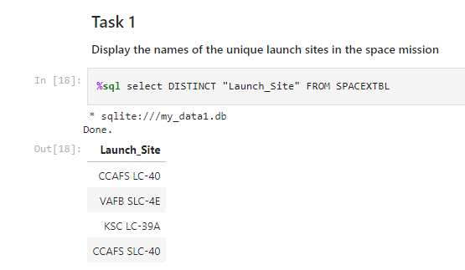
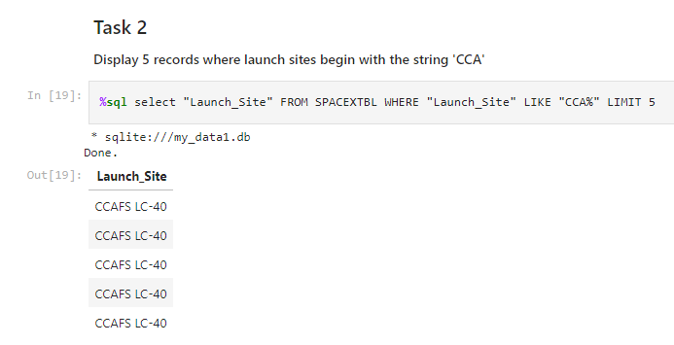
SQL Queries

Slide 16
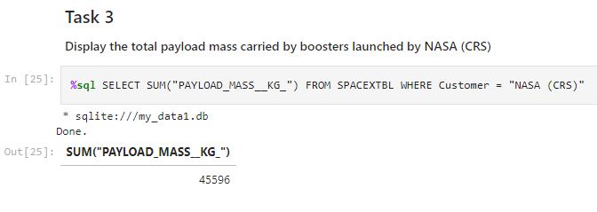
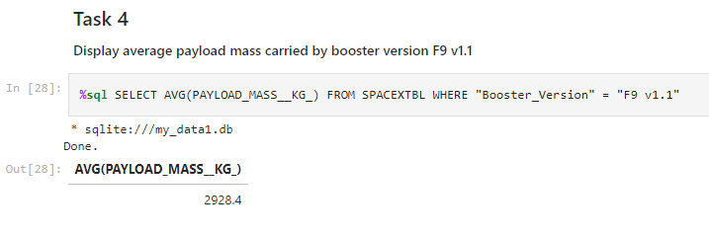
SQL Queries Con’t

Slide 17
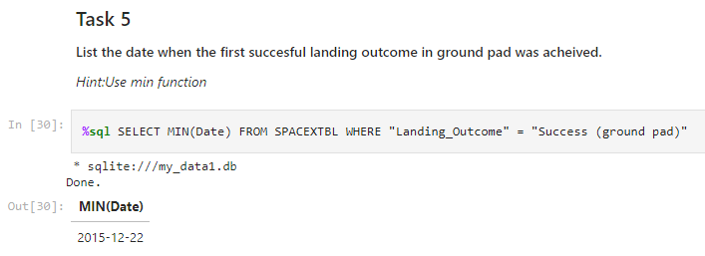
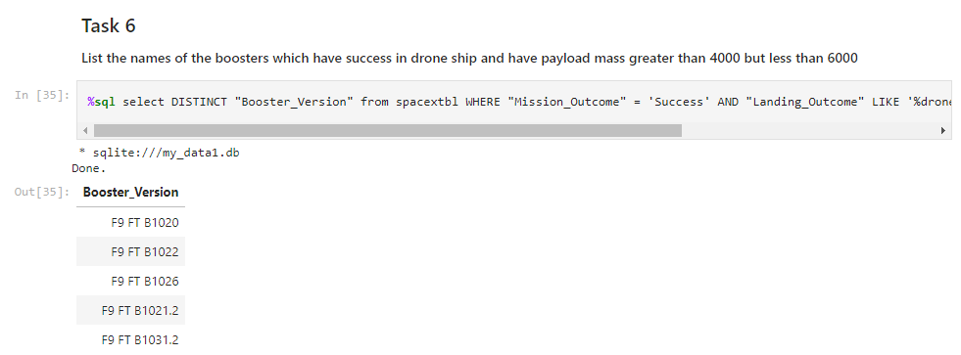
SQL Queries Con’t

Slide 18
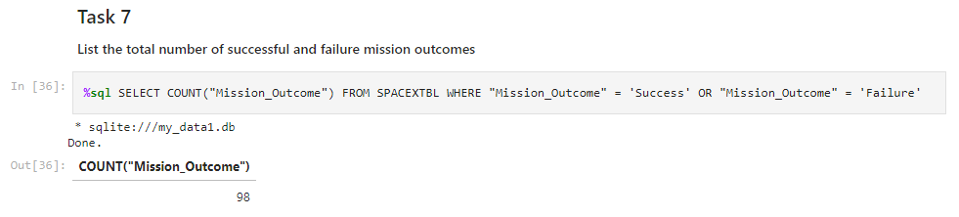
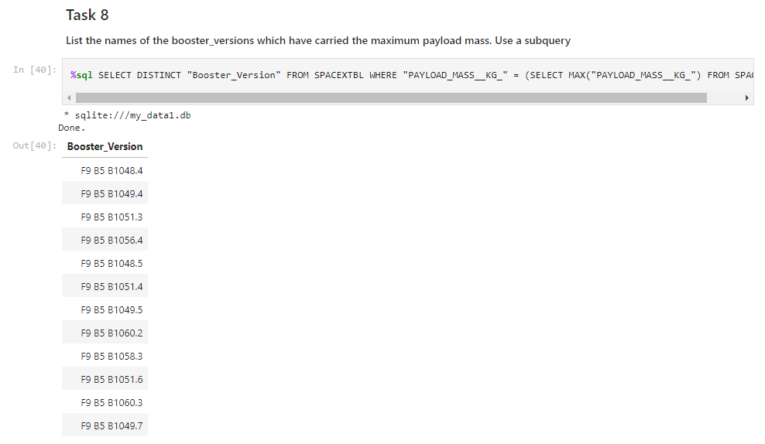
SQL Queries Con’t

Slide 19
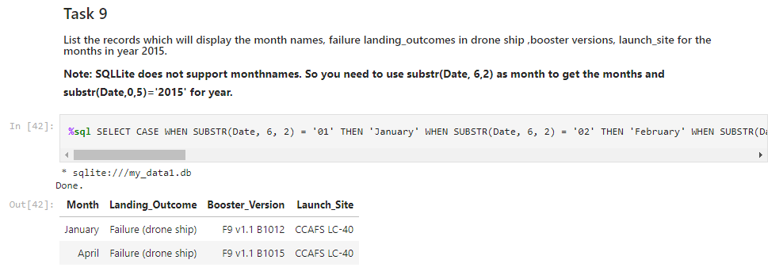
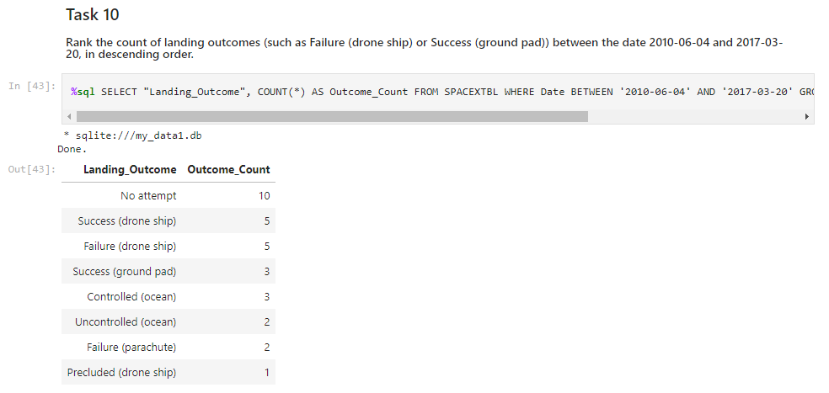
SQL Queries Con’t

Slide 20
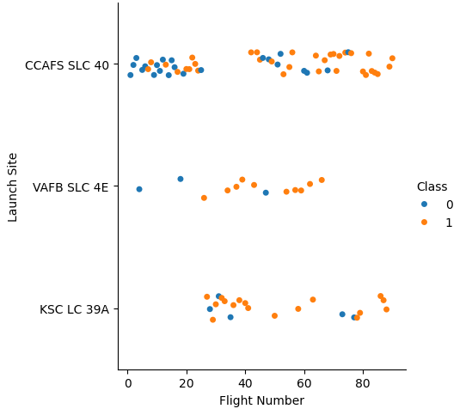
Flight Number vs. Launch Site
CCAFS SLC 40 had the majority of the early launches with a lower success rate
VAFB SLC 4E doesn’t have any launches beyond flight number ~65, as well as having the least total launches overall
KSC LC 39A had no launches prior to flight number ~25
Distribution of flights between the different launch sites

Slide 21
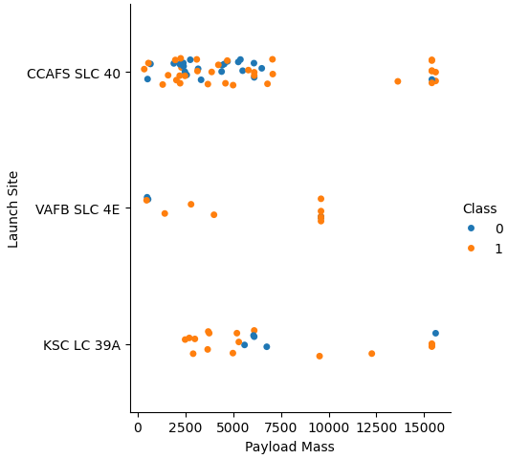
Payload vs. Launch Site
There are few launches with a payload mass between 7,500 and 12,500
VAFB SLC 4E launched no rockets with a payload mass above 10,000
Distribution of payload mass by launch site

Slide 22
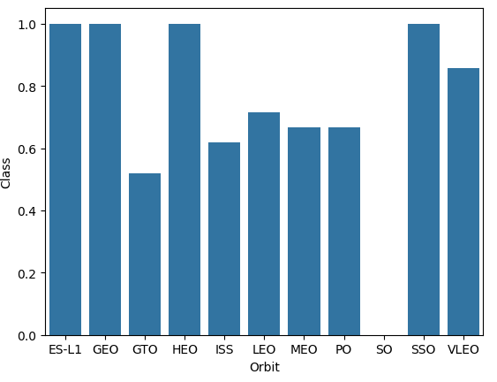
Success Rate vs. Orbit Type
SO orbits had zero successful launches
ES-L1 GEO, HEO and SSO all had perfect launch success
The rest were slightly above 50% aside from VLEO at above 80% success rate
It’s important to consider the number of launches for each orbit type!
Every orbit type and it’s respective launch success rate

Slide 23
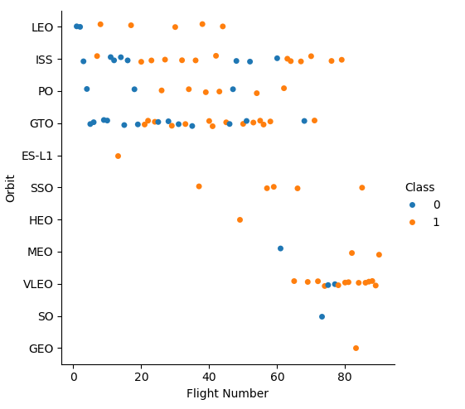
Flight Number vs. Orbit Type
SSO having perfect success rate is most noteworthy as it has more than one launch
SO has only one launch
The orbit types slightly above 50% all had many launches
Flight Number for each orbit type

Slide 24
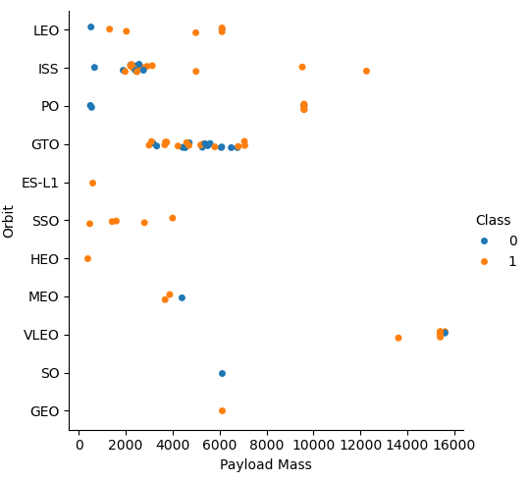
Payload vs. Orbit Type
Heavy payloads lend themselves towards VLEO orbits
Most orbits are geared towards lighter payloads
Payload mass distribution by orbit type

Slide 25
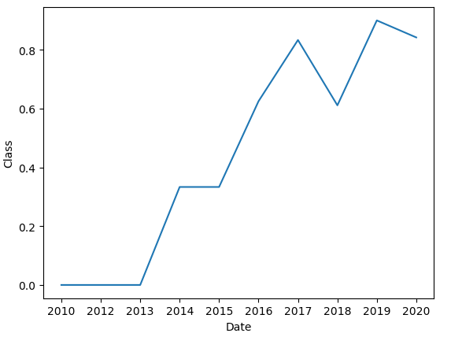
Launch Success Yearly Trend
Launch success rate has increased over time
Launch success rate by year

Slide 26

Section 3

Slide 27
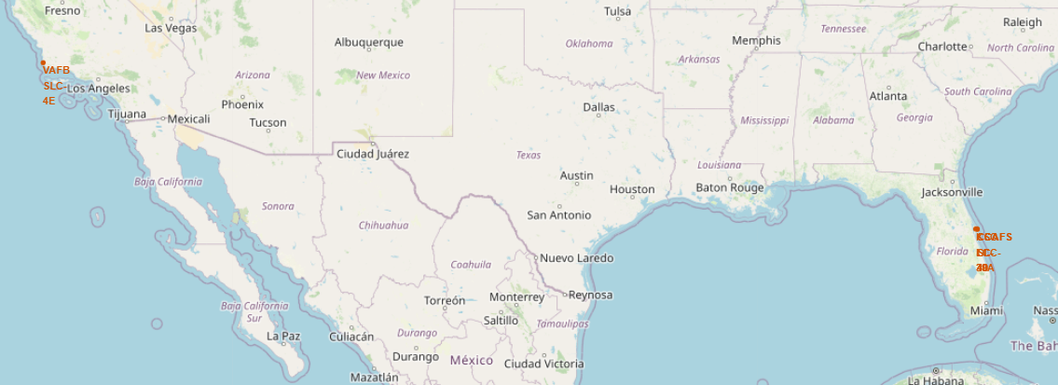
Launch Site Locations
All launch sites are near each other in Florida, aside from VAFB SLC-4E in California

Slide 28
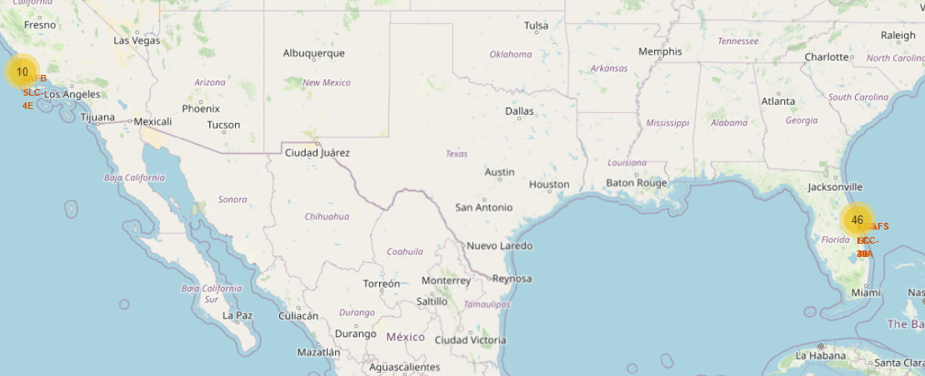
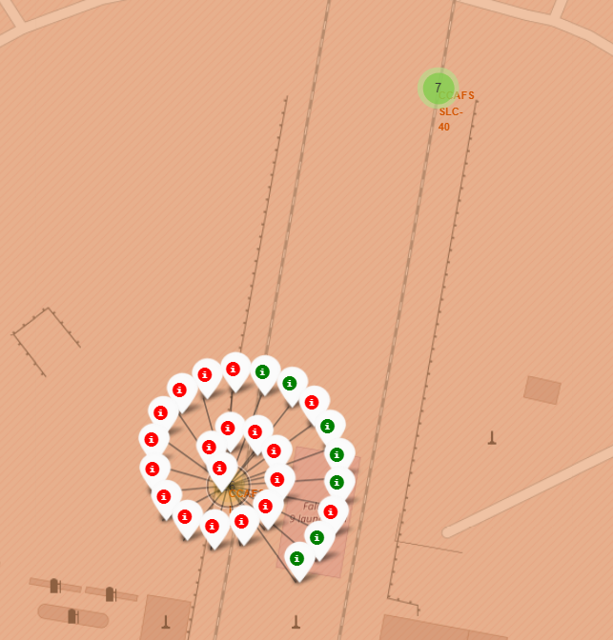
Success/Failed Launches
Used marker_cluster to showcase successful and failed launch outcomes at each launch site

Slide 29
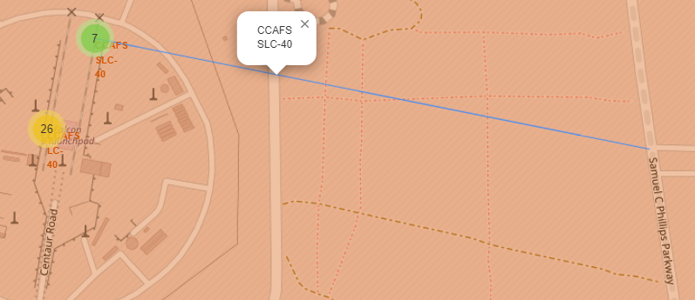
Launch Site Proximities
On the coast
Near railroads
Near highways
Far from cities
Showcasing distance from CCAFS SLC-40 to the nearest highway

Slide 30

Section 4

Slide 31
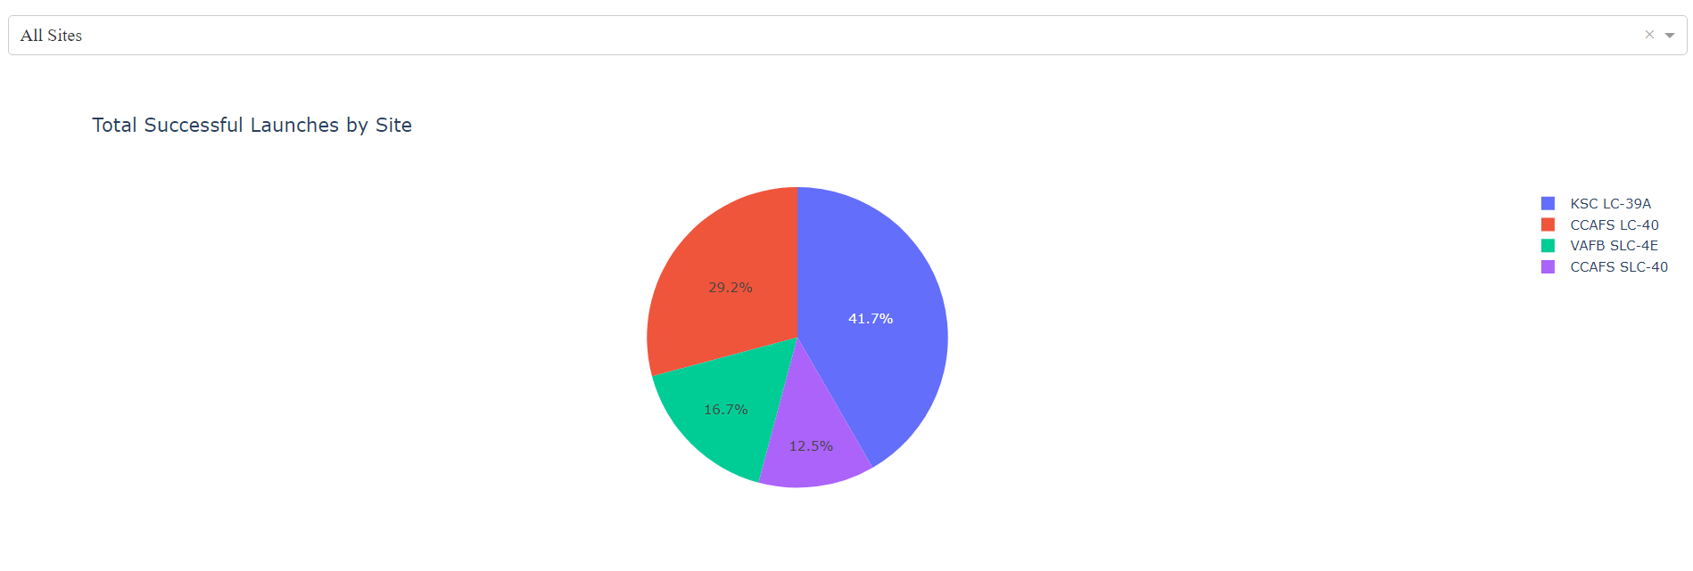
Successful Launches Distribution
Pie chart showcasing the breakdown of successful launches by site

Slide 32
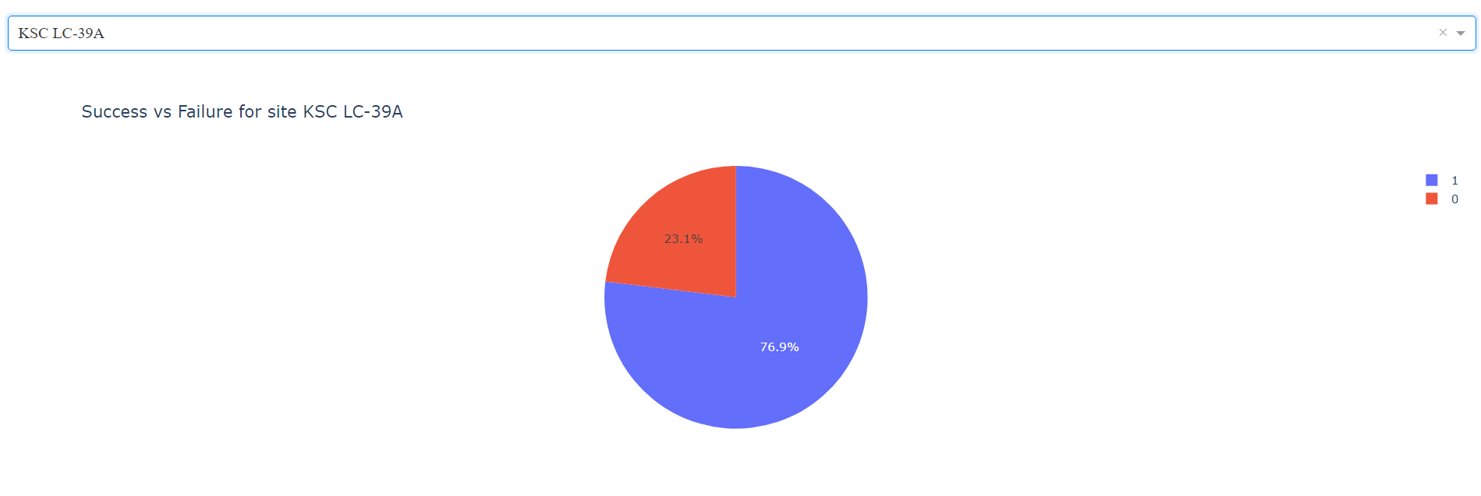
KSC LC-39A Success vs Failure
KSC LC-39A has the highest success rate at 76.9%

Slide 33
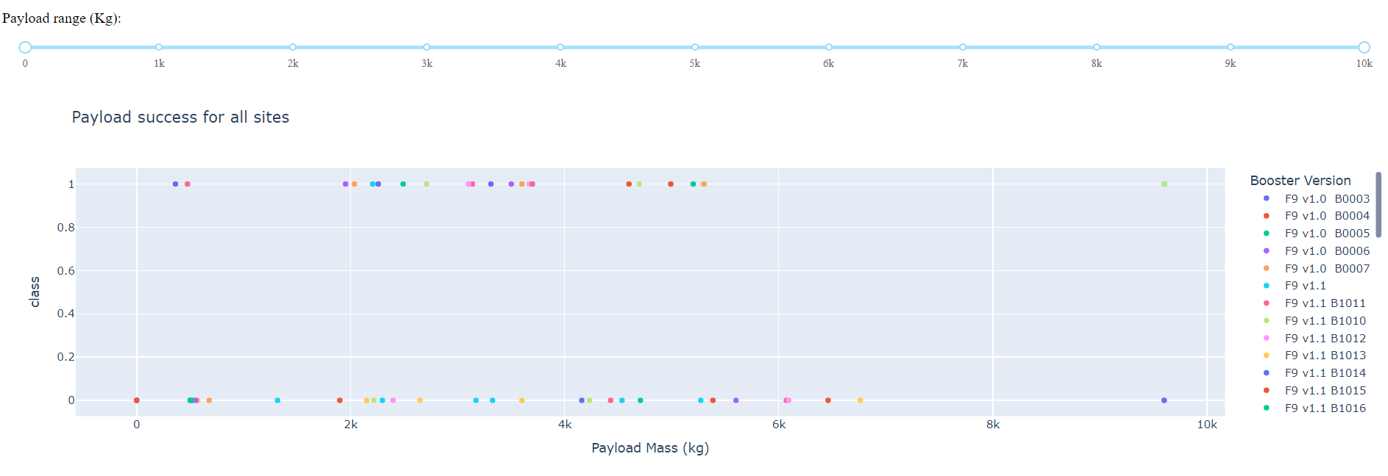
Payload Mass on Success
Scatter plot of success/failure vs payload mass across different booster versions
Payload mass range slider

Slide 34

Section 5

Slide 35
Classification Accuracy
Models evaluated:
Logistic regression
Supper vector machine
Decision tree classifier
K nearest neighbors
Decision tree classifier had the best accuracy at 88.93%
Best tuned hyperparameters: {‘criterion’ : ‘entropy’, ‘max_depth’ : 16, ‘max_features’ : ‘sqrt’, ‘min_samples_leaf’ : 4, ‘min_samples_split’ : 10, ‘splitter’ : ‘best’}

Slide 36
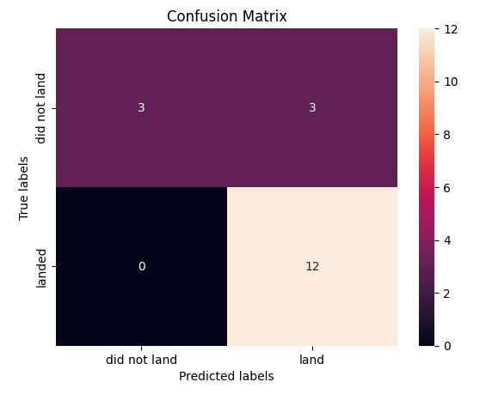
Confusion Matrix
Only 3 of the 18 labels were classified incorrectly
Limited testing data could lead to high variance
Confusion matrix for our decision tree classifier model

Slide 37
Conclusions
Correlating key features with launch success is tantamount to the success of any business in this industry
The data reveals, for instance, that certain orbit types lend themselves to higher success rates, while others lead towards more failures
Developing a machine learning model, such as our decision tree classifier, to predict (with reasonable accuracy) whether a launch will be successful or not helps determine the budget available for that launch
Limited data available in this industry limits confidence in conclusions

Slide 38


